Slide 1
Introduction
Home
Ai
Introduction Adobe
Adobe illustrator
By Graphics Design
Working details

Slide 2
What is adobe illustrator?
Introduction
Home
What is graphics design?
What relation in adobe illustrator & graphics design?
Introduction Adobe
Why will learn graphics design?
Ai
Graphics Design
Working details
PS

Slide 3
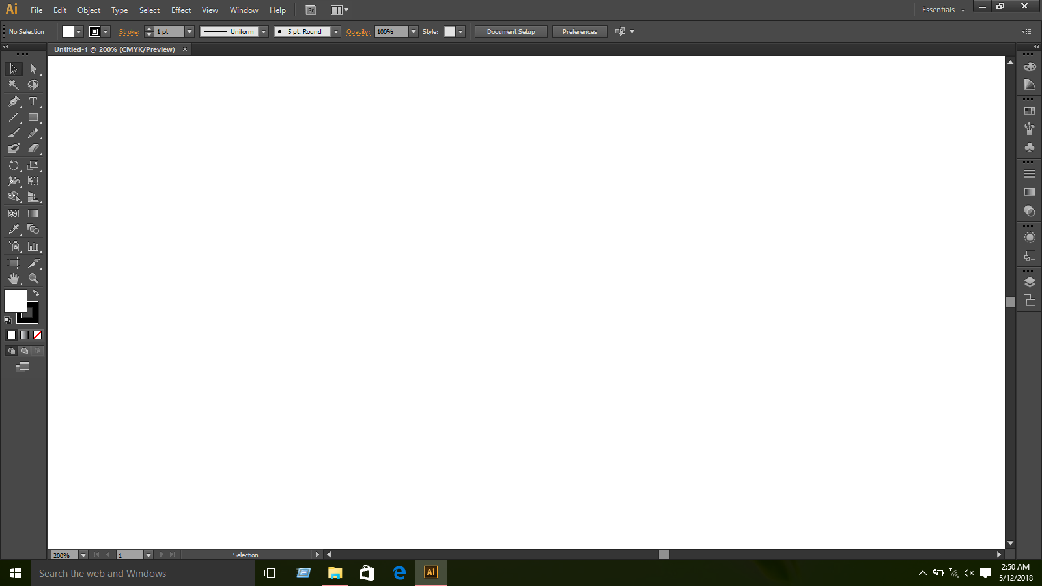
Adobe Interface
Introduction
Home
Introduction Adobe
Working details

Slide 4
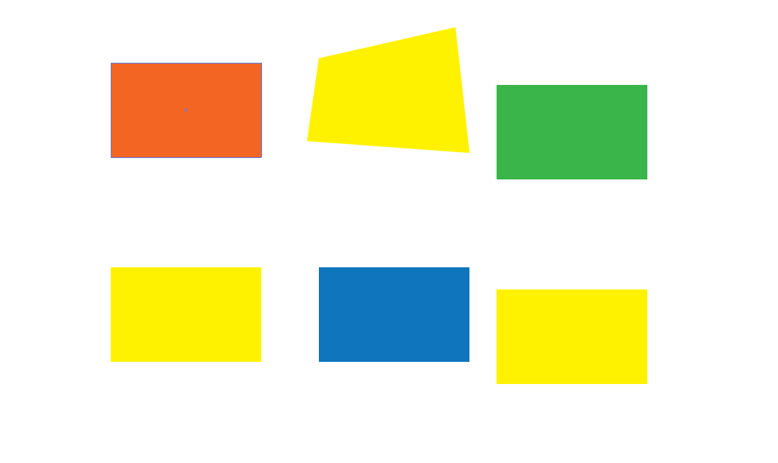
Tools
Selection Tool
Introduction
Home
Direct Selection Tool
Magic Wand Tool
Lasso Tool
Introduction Adobe
Working details

Slide 5

Pen Tools
Type Tools / Vertical Type Tool
Introduction
Home
Area type Tool / Vertical area type tool
Type on a path Tool / vertical type on a path tool
Introduction Adobe
Working details

Slide 6
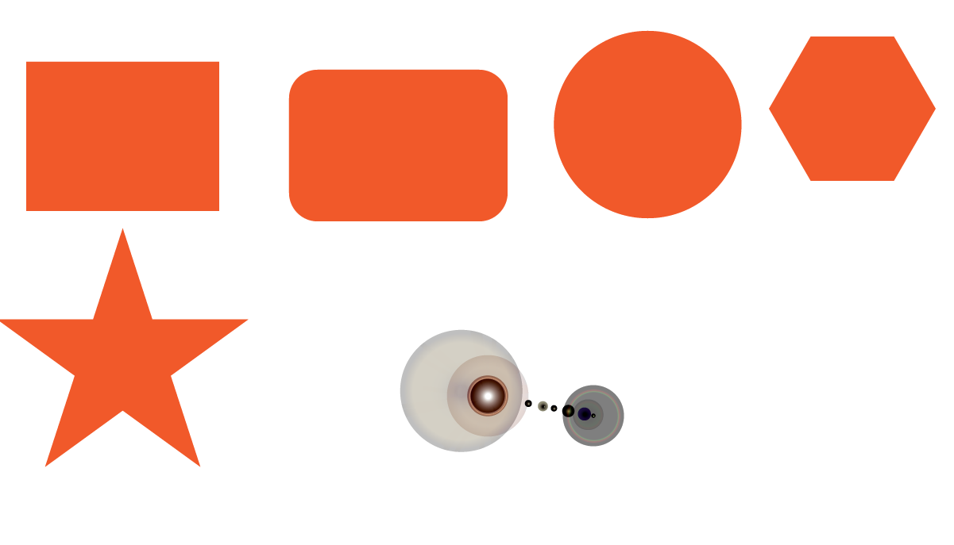
Object
Rectangle Tool / Rounded Rectangle Tool
Introduction
Home
Ellipse Tool
Polygon Tool
Star Tool
Introduction Adobe
Working details

Slide 7


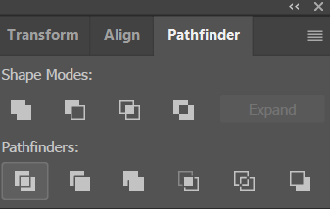
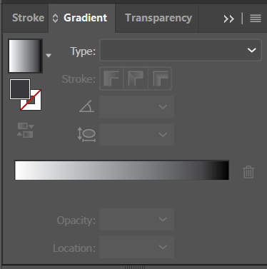

Introduction
Tools
Home
Introduction Adobe
Working details

Slide 8

Introduction
Home
Google Chrome
How I have made it?
Introduction Adobe
Working details

Slide 9

Ice Poster
Introduction
Home
Introduction Adobe
Working details

Slide 10
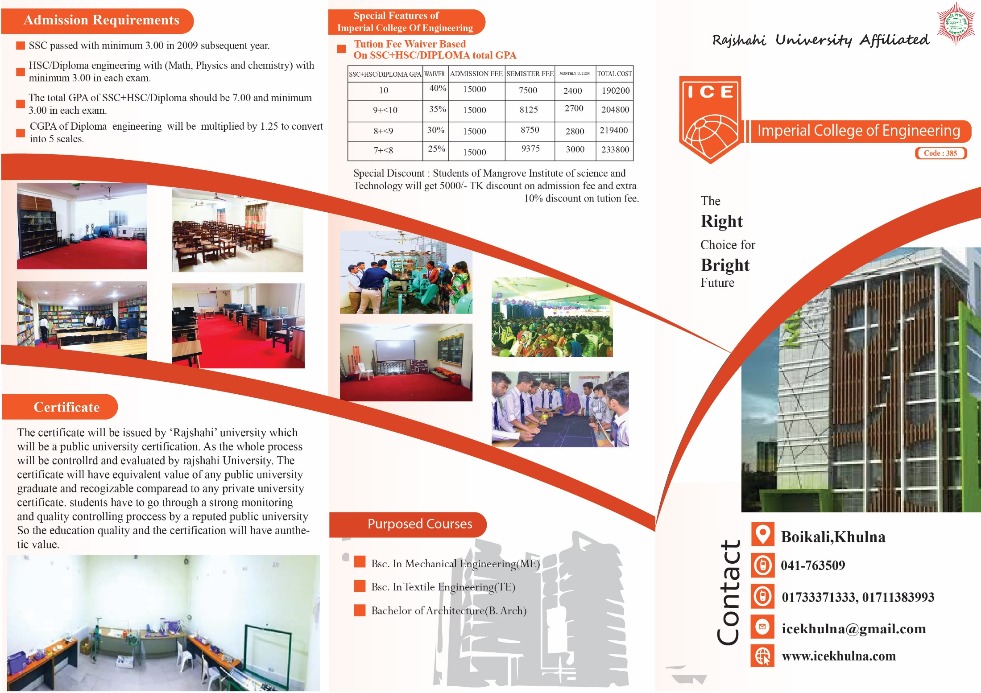
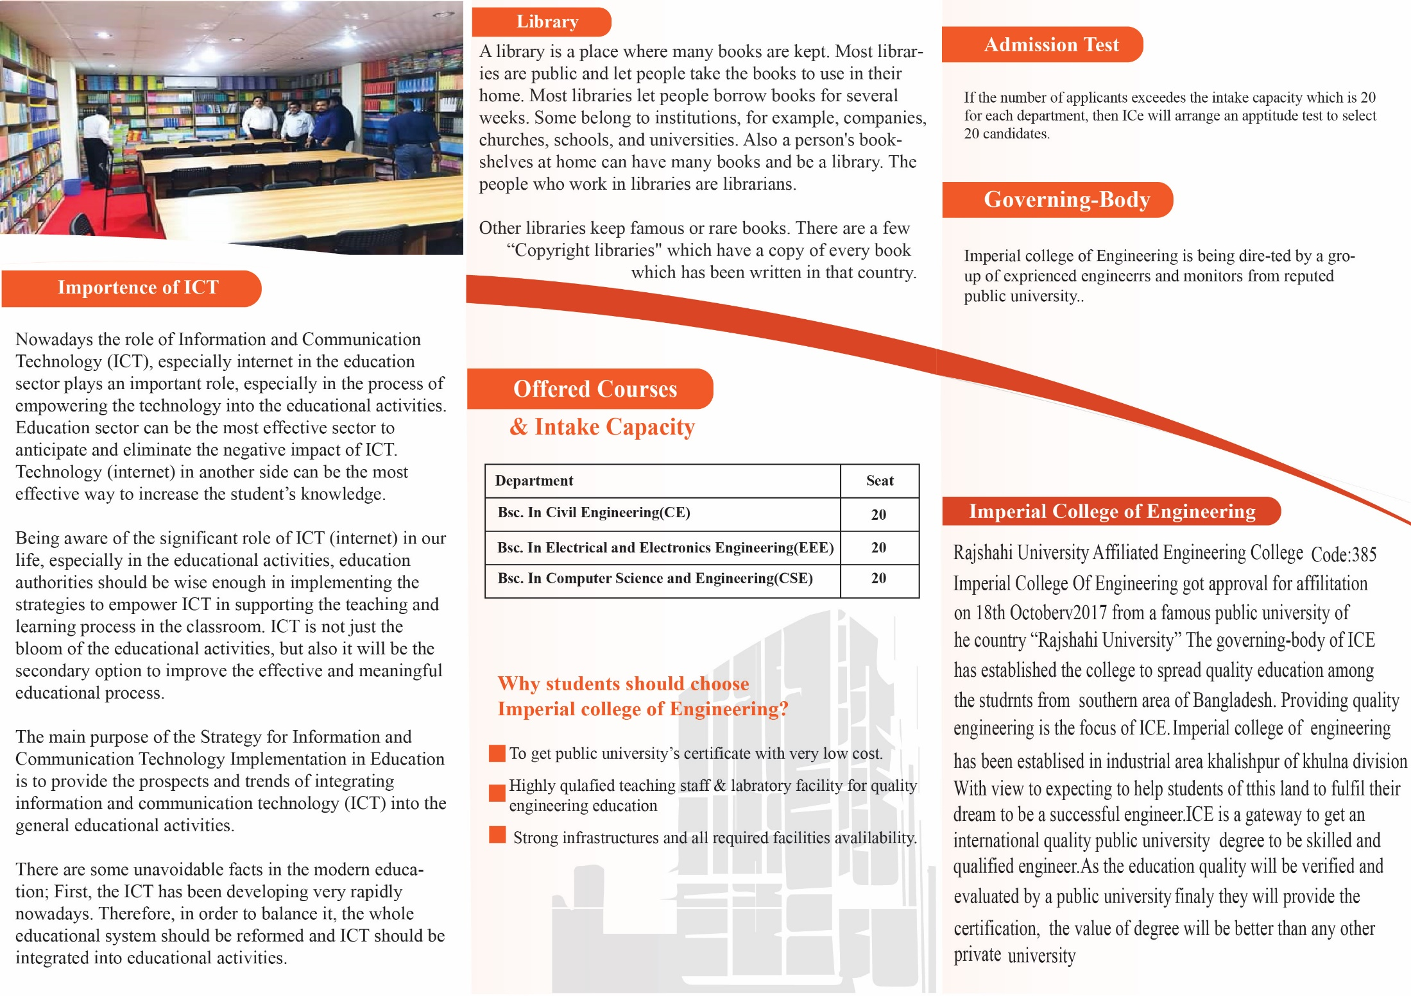
Introduction
Home
Ice Prospectus
Introduction Adobe
Working details

Slide 11
Introduction
Home
Graphics is
a Art
Introduction Adobe
Working details

